Slide 1
Performance Analysis

Slide 2
Performance Analysis
There are problems and algorithms to solve them.
Problems and problem instances.
Example: Sorting data in ascending order.
Problem: Sorting
Problem Instance: e.g. sorting data (2 3 9 5 6 8)
Algorithms: Bubble sort, Merge sort, Quick sort, Selection sort, etc.
Which is the best algorithm for the problem? How do we judge?

Slide 3
Performance Analysis
Two criteria are used to judge algorithms: (i) time complexity (ii) space complexity.
Space Complexity of an algorithm is the amount of memory it needs to run to completion.
Time Complexity of an algorithm is the amount of CPU time it needs to run to completion.

Slide 4
Space Complexity
Why?
To know in advance about sufficient memory
To select the program with minimum memory requirement
To estimate the largest instance it can solve

Slide 5
Components of Space Complexity
Instruction space
Space needed to store the compiled version of program instruction
Depends on…
The compiler used to compile the program
Ex. a+b + (b*c) + (a+b-c) / (a+b)/4
The compiler options in effect
Ex. Overlay option
The target computer
Floating point hardware

Slide 6
Components of Space Complexity
2. Data space
Space needed by constants and simple variables
Space needed by dynamically allocated objects (arrays, class instance etc.)
3. Environmental stack space
The return address
All local variables
All formal parameters
Recursion stack space
The space needed by local variables & formal parameters
The maximum depth of recursion

Slide 7
Space Complexity
Memory space S(P) needed by a program P, consists of two components:
A fixed part: needed for instruction space (byte code), simple variable space, constants space etc. → c
A variable part: dependent on a particular instance of input and output data. → S_{p}(instance)
S(P) = c + S_{p}(instance)

Slide 8
Space Complexity: Example 1
Algorithm abc (a, b, c)
{
return a+b+b*c+(a+b-c)/(a+b)+4.0;
}
For every instance 3 computer words required to store variables: a, b, and c. Therefore S_{p}()= 3. S(P) = 3.

Slide 9
Space Complexity: Example 2
Algorithm Sum(a[], n)
{
s:= 0.0;
for i = 1 to n do
s := s + a[i];
return s;
}

Slide 10
Space Complexity: Example 2.
Every instance needs to store array a[] & n.
Space needed to store n = 1 word.
Space needed to store a[ ] = n floating point words (or at least n words)
Space needed to store i and s = 2 words
S_{p}(n) = (n + 3). Hence S(P) = (n + 3).

Slide 11
Space Complexity: Example 3
Algorithm RSum(a[], n)
{
if (n > 0)
return Rsum(a,n-1) + a[n-1];
return 0;
}

Slide 12
Space Complexity: Example 3
Every recursive function call needs to store address of array a[], the value of n & return address.
Space needed to store n = 1 word.
Space needed to store the address of a[ ] = 1 word
Space needed to store return address = 1 words
Depth of recursion = n+1
Space needed to store a[] = n words
S_{p}(n) = n. Hence S(P) = 3(n + 1) + n.

Slide 13
Space Complexity: Example 4
Algorithm Fact(int n)
{
if (n <= 1)
return 1;
else return (n * Fact(n-1));
}

Slide 14
Space Complexity: Example 4
Every recursive function call needs to store the value of n & return address.
Space needed to store n = 1 word.
Space needed to store return address = 1 words
Depth of recursion = n
Hence S(P) = 2(n)

Slide 15
Time Complexity
Time required T(P) to run a program P also consists of two components:
A fixed part: compile time which is independent of the problem instance → c.
A variable part: run time which depends on the problem instance → t_{p}(instance)
T(P) = c + t_{p}(instance)

Slide 16
Time Complexity
How to measure T(P)?
Measure experimentally, using a “stop watch”
T(P) obtained in secs, msecs.
Count no. of major operations / instructions.
Identify one or more major operations and determine how many times each is executed.
Ignore the other minor operations / instructions.
Count program steps → T(P) obtained as a step count.
Fixed part is usually ignored; only the variable part t_{p}() is measured.

Slide 17
Operation count : Example 1
Algorithm IndexOfMax(int a[], int n)
{
int index = 0;
for(int i=1; i<n; i++)
if (a[index] < a[i])
index = i;
return index;
}
Comparison can be considered as major operation in above algorithm.
Total number of comparison = max{n-1, 0 }
Hence, T(P) = n-1

Slide 18
Operation count : Example 2
Algorithm PolyEval(int coeff[], int n, int x)
{
int y=1, value=coeff[0] ;
for(int i=1; i<n; i++)
{
y = y * x;
value = value + y * coeff[i];
}
}

Slide 19
Operation count : Example 2
Here, additions and multiplications can be identified as major operations.
Total number of additions = n
Total number of multiplications = 2n
Hence, total number of operations = 3n
T(P) = 3n

Slide 20
Step Count
Considers all executable statements of an algorithm.
What is a program step?
a+b+b*c+(a+b)/(a-b) → one step;
comments → zero steps;
while (<expr>) do → step count equal to the number of times <expr> is executed.
for i=<expr> to <expr1> do → step count equal to number of times <expr1> is checked.

Slide 21
Step Count : Example 1
 | Statements | S/E | Freq. | Total
1 | Algorithm Sum(a[],n) | 0 | - | 0
2 | { | 0 | - | 0
3 | S = 0.0; | 1
4 | for i=1 to n do | 1
5 | s = s+a[i]; | 1
6 | return s; | 1
7 | } | 0 | - | 0

Slide 22
Step Count : Example 1
 | Statements | S/E | Freq. | Total
1 | Algorithm Sum(a[],n) | 0 | - | 0
2 | { | 0 | - | 0
3 | S = 0.0; | 1 | 1 | 1
4 | for i=1 to n do | 1 | n+1 | n+1
5 | s = s+a[i]; | 1 | n | n
6 | return s; | 1 | 1 | 1
7 | } | 0 | - | 0
2n+3

Slide 23
Step Count : Example 2
 | Statements | S/E | Freq. | Total
1 | Algorithm Sum(a[],n,m) | 0 | - | 0
2 | { | 0 | - | 0
3 | for i=1 to n do; | 1
4 | for j=1 to m do | 1
5 | s = s+a[i][j]; | 1
6 | return s; | 1
7 | } | 0 | - | 0

Slide 24
Step Count : Example 2
 | Statements | S/E | Freq. | Total
1 | Algorithm Sum(a[],n,m) | 0 | - | 0
2 | { | 0 | - | 0
3 | for i=1 to n do; | 1 | n+1 | n+1
4 | for j=1 to m do | 1 | n(m+1) | n(m+1)
5 | s = s+a[i][j]; | 1 | nm | nm
6 | return s; | 1 | 1 | 1
7 | } | 0 | - | 0
2nm+2n+2

Slide 25
Step Count : Example 3
 | Statements | S/E | Freq. | Total
1 | Algo Transpose(a[],row) | 0 | - | 0
2 | { | 0 | - | 0
3 | for (i=0; i<row ; i++) | 1
4 | for (j=i+1; j<row; j++) | 1
5 | swap(a[i][j],a[j][i]); | 1
7 | } | 0 | - | 0

Slide 26
Step Count : Example 3
 | Statements | S/E | Freq. | Total
1 | Algo Transpose(a[],row) | 0 | - | 0
2 | { | 0 | - | 0
3 | for (i=0; i<row ; i++) | 1 | row+1 | row+1
4 | for (j=i+1; j<row; j++) | 1 | row(row+1)/2 | row(row+1)/2
5 | swap(a[i][j],a[j][i]); | 1 | row(row-1)/2 | row(row-1)/2
7 | } | 0 | - | 0
row² + row + 1

Slide 27
Step Count : Example 4
 | Statements | S/E | Freq. | Total
1 | Algorithm ABC(a[],b[],n) | 0 | - | 0
2 | { | 0 | - | 0
3 | for (j=0; j<n ; j++) | 1
4 | b[j] = sum(a,j+1); | 2j+6
5 | } | 0 | - | 0

Slide 28
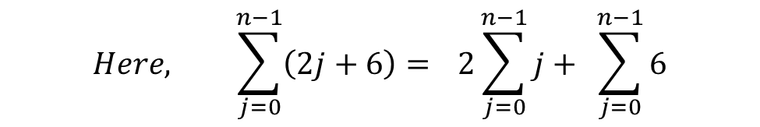
Step Count : Example 4
 | Statements | S/E | Freq. | Total
1 | Algorithm ABC(a[],b[],n) | 0 | - | 0
2 | { | 0 | - | 0
3 | for (j=0; j<n ; j++) | 1 | n+1 | n+1
4 | b[j] = sum(a,j+1); | 2j+6 | n | n(n+5)
5 | } | 0 | - | 0
n² + 6n + 1
$$Here, \sum_{j=0}^{n−1}{\left(2j+6\right)= }2\sum_{j=0}^{n−1}{j+ }\sum_{j=0}^{n−1}{6}$$

Slide 29
Problem with step count
Doesn’t give accurate estimate of time complexity, because step is not well defined
For ex,
T(P1) = 4n² + 6n + 2 OR
T(P1) = 5n² + 7n + 3 is correct for a given program P1?
Consider R = x² + 3x + 5 as x varies:
x = 0 x² = 0 3x = 0 5 = 5 R = 5
x = 10 x² = 100 3x = 30 5 = 5 R = 135
x = 100 x² = 10000 3x = 300 5 = 5 R = 10,305
x = 1000 x² = 1000000 3x = 3000 5 = 5 R = 1,003,005
x = 10,000 x² = 10⁸ 3x = 3*10⁴ 5 = 5 R = 100,030,005
x = 100,000 x² = 10¹⁰ 3x = 3*10⁵ 5 = 5 R = 10,000,300,005

Slide 30
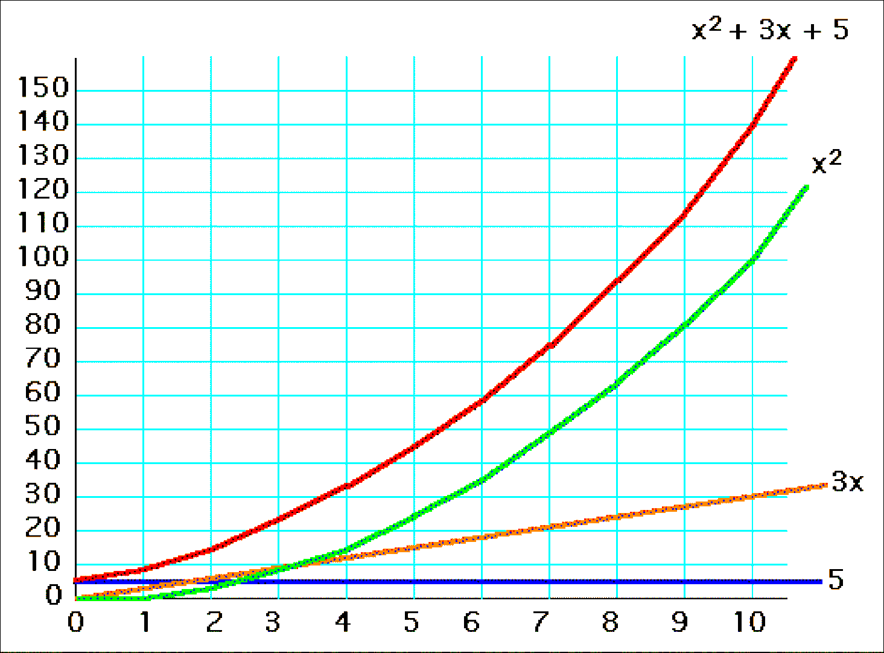
R = x² + 3x + 5 for x= 1..10

Slide 31
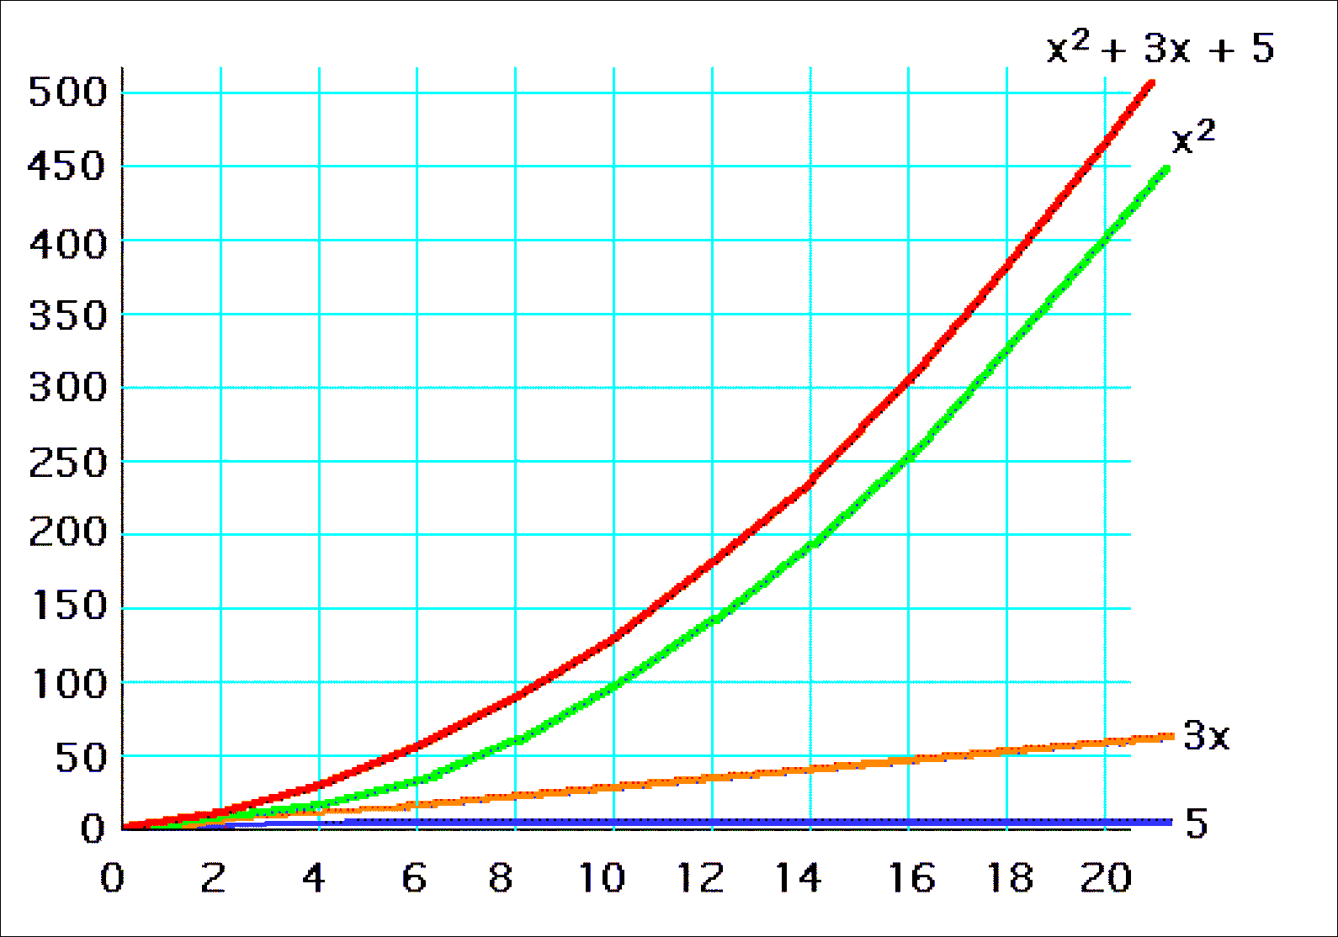
R = x² + 3x + 5 for x= 1..20

Slide 32
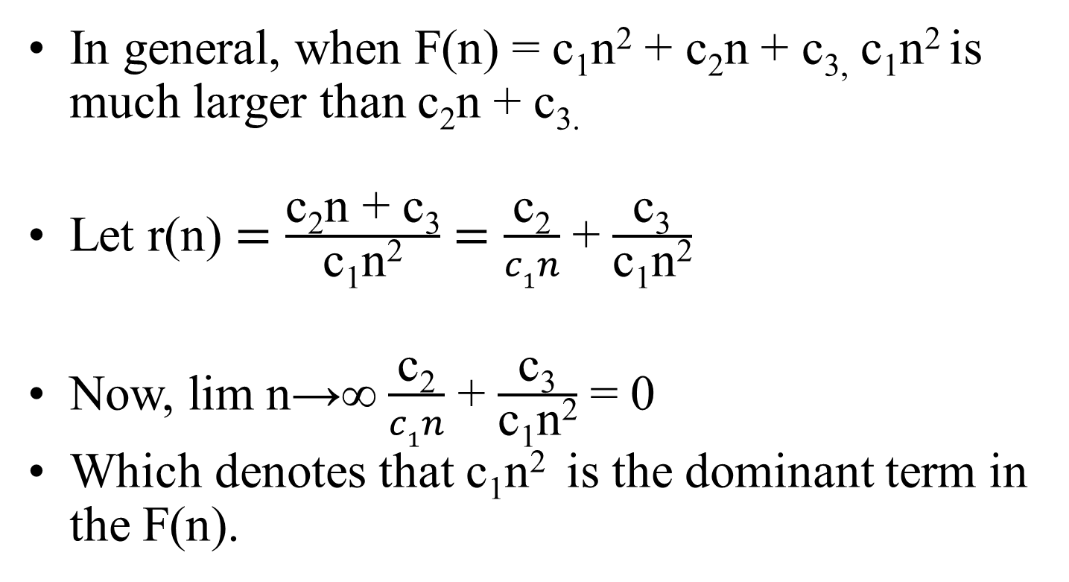
Observation with step count
In general, when F(n) = c₁n² + c₂n + c_{3,}c₁n² is much larger than c₂n + c_{3.}
Let r(n) $=\frac{\text{c}\text{2}\text{n}\text{ + }\text{c}\text{3}}{\text{c}\text{1}\text{n}\text{2}}=\frac{\text{c}\text{2}}{c1n}$ + $\frac{\text{c}\text{3}}{\text{c}\text{1}\text{n}\text{2}}$
Now, lim n→∞ $\frac{\text{c}\text{2}}{c1n}$ + $\frac{\text{c}\text{3}}{\text{c}\text{1}\text{n}\text{2}}$ = 0
Which denotes that c₁n² is the dominant term in the F(n).

Slide 33
Observation with step count
For two programs A & B,
Analysis of John:
t_{A}(n) = n² + 3n t_{B}(n) = 43n
Analysis of Mary:
t_{A}(n) = 2n² + 3n t_{B}(n) = 83n
For John:
when n<40, program A is faster
when n>40, program B is faster
For Mary:
when n<80, program A is faster
when n>80, program B is faster

Slide 34
Observation with step count
In both the cases, Program A is faster than program B.
Just the break even point (n=40 or n=80) changes.
Hence, the value of coefficient is irrelevant.
Thus, to reflect how one function grows with the growth of another function, study of asymptotic notation is required.

Slide 35
Growth of Functions
The growth of time and space complexity with increasing input size n is a suitable measure for the comparison of algorithms.
The growth of functions is usually described using the Asymptotic notations
Three most important asymptotic notations are as follows:
Big – O notation
Omega notation
Theta notation

Slide 36
Big – O notation
Definition: Let f and g be functions from the integers or the real numbers to the real numbers. We say that f(n) is O(g(n)), if there are exist constants C and n₀ such that,
f(n) ≤ C g(n)
whenever n >= n₀ .

Slide 37
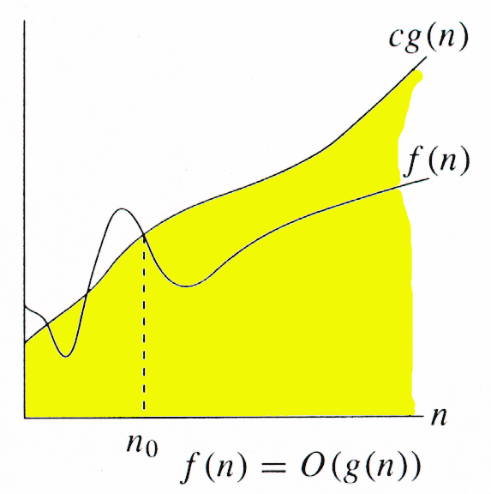
Big – O notation
Graphically, it can be represented as follows:

Slide 38
Big – O notation
The idea behind the big-O notation is to establish an upper boundary for the growth of a function f(n) for large n.
We accept the constant C in the requirement
f(n) ≤ Cg(n) whenever n ≥n₀,
because C does not grow with x
We are only interested in large n, so it is OK if f(n) > Cg(n) for n ≥ n₀.

Slide 39
Big – O Examples
Prove that f(n) = 3n + 5 is O(n).
f(n) = 3n + 5
≤ 3n + n , where n ≥ 5
≤ 4n
≤ C g(n) , where C=4 & n₀=5
Hence, f(n) = 3n + 5 is O(n) is proved.
Similarly, Prove for the followings:
f(n) = 27n² + 16n is O(n²).
f(n) = 2n³ + n² + 2n is O(n³).
f(n) = 4n³ + 2n + 3 is O(n³).
f(n) = 2^{n} + 6n² + 3n is O(2^{n}).

Slide 40
Big – O Examples – Incorrect bound
Prove that f(n) = 7n + 5 ≠ O(1).
Proof by contradiction:
Assume that 7n + 5 = O(1). So, we must have
7n + 5 ≤ C.1 for n ≥ n0.
above statement is not true for large values of n
Hence, our assumption is false.
Hence, f(n) = 3n + 5 is O(n) is proved.
Similarly, Prove for the followings:
f(n) = 10n² + 7 ≠ O(n).
f(n) = 27n² + 16n + 25 ≠ O(n).
f(n) = 3n³ + 4n ≠ O(n²).

Slide 41
Big – O notation – Loose bounds
Question: If f(x) is O(x²), is it also O(x³)?
Yes. x³ grows faster than x², so x³ grows also faster than f(x).
Therefore, we always have to find the smallest simple function g(x) for which f(x) is O(g(x)).
Ex: f(n) = 2n + 3 = O(n²)

Slide 42
Big – Ω notation
Definition: Let f and g be functions from the integers or the real numbers to the real numbers. We say that f(n) is Ω(g(n)), if there are exist constants C and n₀ such that,
f(n) ≥ C g(n)
whenever n >= n₀ .

Slide 43
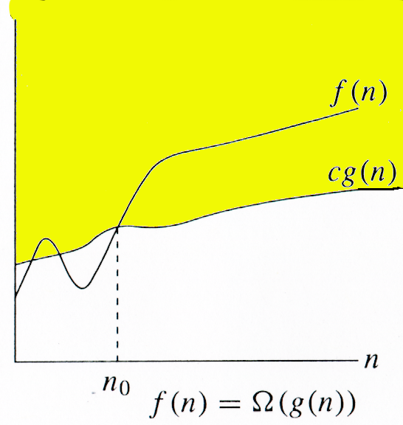
Big – Ω notation
Graphically, it can be represented as follows:

Slide 44
Big – Ω notation
The idea behind the big- Ω notation is to establish an lower boundary for the growth of a function f(n) for large n.
It indicates the best case.

Slide 45
Big – Ω Examples
Prove that f(n) = 3n + 5 is Ω(n).
f(n) = 3n + 5
≥ 3n , where n ≥ 1
≥ C g(n) , where C=3 & n₀=1
Hence, f(n) = 3n + 5 is Ω(n) is proved.
Similarly, Prove for the followings:
f(n) = 27n² + 16n is Ω(n²).
f(n) = 2n³ + n² + 2n is Ω(n³).
f(n) = 4n³ + 2n + 3 is Ω(n³).
f(n) = 2^{n} + 6n² + 3n is Ω(2^{n}).

Slide 46
Big – Ω Examples – Incorrect bound
Prove that f(n) = 7n + 5 ≠ Ω(n²).
Proof by contradiction:
Assume that 7n + 5 = Ω(n²). So, we must have
7n + 5 ≥ C n² for n ≥ n0.
c n² / (7n + 5) ≤ 1.
above statement is not true for n.
Hence, our assumption is false.
Hence, f(n) = 3n + 5 is Ω(n) is proved.
Similarly, Prove for the followings:
f(n) = 10n² + 7 ≠ Ω(n³).
f(n) = 27n² + 16n + 25 ≠ Ω(n³).
f(n) = 3n³ + 4n ≠ Ω(2^{n}).

Slide 47
Big – Ω notation – Loose bounds
Question: If f(x) is Ω (x³), is it also Ω(x²)?
Yes.
Therefore, we always have to find the Largest simple function g(x) for which f(x) is Ω(g(x)).
Ex: f(n) = 2n + 3 = Ω(n²)

Slide 48
Big – ϴ notation
Definition: Let f and g be functions from the integers or the real numbers to the real numbers. We say that f(n) is ϴ(g(n)), if there are exist constants C₁, C₂ and n₀ such that,
C₁ g(n) ≤ f(n) ≤ C₂ g(n)
whenever n >= n₀ .

Slide 49
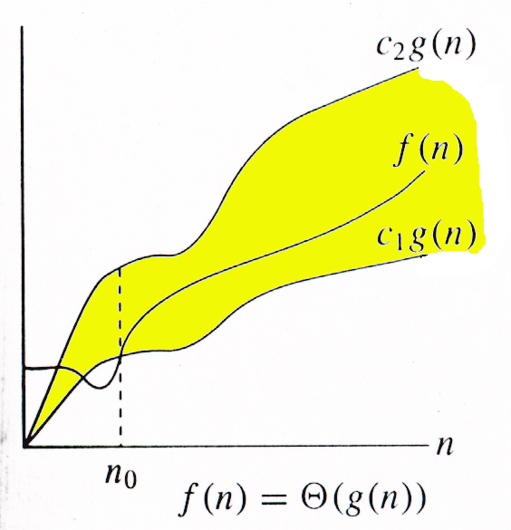
Big – ϴ notation
Graphically, it can be represented as follows:

Slide 50
Relation between O, Ω and ϴ
For any two functions g(n) and f(n), f(n) = Θ(g(n)) iff
f(n) = O(g(n)) and f(n) = Ω(g(n)).
I.e., Θ(g(n)) = O(g(n)) ∩ Ω(g(n))

Slide 51
Big – ϴ notation - Examples
Prove that f(n) = 3n + 5 is ϴ(n).
We can say that 3n ≤ 3n + 5
C₁ n ≤ f(n), where C₁ = 3
similarly, f(n) = 3n + 5
≤ 3n + n , where n ≥ 5
≤ 4n
≤ C₂ g(n) , where C₂=4
Hence, f(n) = 3n + 5 is ϴ(n) is proved.
Similarly, Prove for the followings:
f(n) = 27n² + 16n is ϴ(n²).
f(n) = 2n³ + n² + 2n is ϴ(n³).
f(n) = 4n³ + 2n + 3 is ϴ(n³).
f(n) = 2^{n} + 6n² + 3n is ϴ(2^{n}).

